Slide 1
How to Get Your CVPR Paper Rejected?
Ming-Hsuan Yang

Slide 2
Outline
Conferences
Journals
Writing
Presentation
Lessons

Slide 3
Conferences
CVPR – Computer Vision and Pattern Recognition, since 1983
  Annual, held in US
ICCV – International Conference on Computer Vision, since 1987
  Every other year, alternate in 3 continents
ECCV – European Conference on Computer Vision, since 1990
  Every other year, held in Europe

Slide 4
Conferences
ACCV – Asian Conference on Computer Vision
BMVC – British Machine Vision Conference
ICPR – International Conference on Pattern Recognition
SIGGRAPH
NIPS – Neural Information Processing Systems

Slide 5
Conferences
MICCAI – Medical Image Computing and Computer-Assisted Intervention
FG – IEEE Conference on Automatic Face and Gesture Recognition
ICCP – IEEE International Conference on Computational Photography
ICML – International Conference on Machine Learning
IJCAI, AAAI, MVA, ICDR, ICVS, DAGM, CAIP, ICRA, ICASSP, ICIP, SPIE, DCC, WACV, 3DPVT, ACM Multimedia, ICME, …

Slide 6
Conference Location

Slide 7
Conference Location
Me and confernece I want to attend (location vs. reputation)

Slide 8
Conference Organization
General chairs: administration
Program chairs: handling papers
Area chairs:
  Assign reviewers
  Read reviews and rebuttals
  Consolidation reports
  Recommendation
Reviewers
Authors

Slide 9
Review Process
Submission
CVPR/ECCV/ICCV
  Double blind review
  Program chairs: assign papers to area chairs
  Area chairs: assign papers to reviewers
Rebuttal
Results

Slide 10
Area Chair Meetings
Each paper is reviewed by 2/3 area chairs
Area chair make recommendations
Program chairs make final decisions
Virtual meetings
Onsite meetings
  Several panels
  Buddy/triplet

Slide 11
Triage
Area chairs know the reviewers
Reviews are weighted
Based on reviews and rebuttal
  Accept: (decide oral later)
  Reject: don’t waste time
  Go either way: lots of papers
Usually agree with reviewers but anything can happen as long as there are good justifications

Slide 12
Conference Acceptance Rate
ICCV/CVPR/ECCV: ~ 25%
ACCV (2009): ~ 30%
NIPS: ~ 25%
BMVC: ~ 30%
ICIP: ~ 45%
ICPR: ~ 55%
Disclaimer
  low acceptance rate = high quality?

Slide 13
CVPR
Submission
Oral
Overall

Slide 14
ICCV
Submission
Oral
Overall

Slide 15
ECCV
Submission
Oral
Overall

Slide 16
Top 100 Publications - English
For what it is worth (h5 index by Google Scholar)
Nature
The New England Journal of Medicine
Science
…
55. IEEE Conference on Computer Vision and Pattern Recognition (CVPR)
…

Slide 17
Top Publications - E&CS
Nano Letters
…
8. IEEE Conference on Computer Vision and Pattern Recognition (CVPR)
...
16. IEEE Transactions on Pattern Analysis and Machine Intelligence
…

Slide 18
Reactions
Top journal papers
Workshops vs conferences
Waiting for the review or final results
Acceptance
Reject
Mixed feeling
Finding an error
Resubmit?
This time, it will go through
Paper finally accepted
Registration
Oral presentation
Poster presentation

Slide 19
Database Community
Jeffrey Naughton’s ICDE 2010 keynote
What’s wrong with the reviewing process?
How to fix that?

Slide 20
Journals
PAMI – IEEE Transactions on Pattern Analysis and Machine Intelligence, since 1979 (impact factor: 5.96, #1 in all engineering and AI, top-ranked IEEE and CS journal)
IJCV – International Journal on Computer Vision, since 1988 (impact factor: 5.36, #2 in all engineering and AI)
CVIU – Computer Vision and Image Understanding, since 1972 (impact factor: 2.20)

Slide 21
Journals
IVC – Image and Vision Computing
TIP – IEEE Transactions on Image Processing
TMI- IEEE Transactions on Medical Imaging
MVA – Machine Vision and Applications
PR – Pattern Recognition
TMM – IEEE Transactions on Multimedia
…

Slide 22
PAMI Reviewing Process
Associate editor-in-chief (AEIC) assigns papers to associate editors (AE)
AE assigns reviewers
First-round review: 2-4 months
  Accept as is
  Accept with minor revision
  Major revision
  Resubmit as new
  Reject

Slide 23
PAMI Reviewing Process
Second-round review: 2-4 months
  Accept as is
  Accept with minor revision
  Major revision (rare cases)
  Reject
EIC makes final decision
Overall turn-around time: 6 to 12 months
Rule of thumb: 30% additional work beyond a CVPR/ICCV/ECCV paper

Slide 24
IJCV/CVIU Reviewing Process
Similar formats
Slightly longer turn-around time

Slide 25
Journal Acceptance Rate
PAMI
  2013: 151/959: 15.7%
  2014: 160/1018: 15.7%
IJCV: ~ 20% (my guess, no stats)
CVIU: ~ 25% (my guess, no stats)

Slide 26
From Conferences to Journals
How much additional work?
  30% additional more work for PAMI?
  As long as the journal version is significantly different from the conference one
Novelty of each work
  Some reviewers still argue against this
  Editors usually accept paper with the same ideas

Slide 27
How to Get Your CVPR Paper Rejected?
Jim Kajia (SIGGRAPH 93 papers chair): How to get your SIGGRAPH paper rejected?
Bill Freeman: How to write a good CVPR submission
Do not
  Pay attention to review process
  Put yourself as a reviewer to exam your work from that perspective
  Put the work in right context
  Carry out sufficient amount of experiments
  Compare with state-of-the-art algorithms
  Pay attention to writing

Slide 28
Review Form
Summary
Overall Rating
  Definite accept, weakly accept, borderline, weakly reject, definite reject
Novelty
  Very original, original, minor originality, has been done before
Importance/relevance
  Of broad interest, interesting to a subarea, interesting only to a small number of attendees, out of CVPR scope

Slide 29
Review Form
Clarity of presentation
  Reads very well, is clear enough, difficult to read, unreadable
Technical correctness
  Definite correct, probably correct but did not check completely, contains rectifiable errors, has major problems
Experimental validation
  Excellent validation or N/A (a theoretical paper), limited but convincing, lacking in some aspects, insufficient validation
Additional comments
Reviewer’s name

Slide 30
Learn from Reviewing Process
Learn how others/you can pick apart a paper
Learn from other’s mistakes
Get to see other reviewers evaluate the same paper
See how authors rebut comments
Learn how to write good papers
Learn what it takes to get a paper published

Slide 31
Put Yourself as Reviewer
Reviewer’s perspective
How a paper gets rejected?
What are the contributions?
Does it advance the science in the filed?
Why you should accept this paper?
Is this paper a case study?
Is this paper interesting?
Who is the audience?

Slide 32
Novelty
What is new in this work?
  Higher accuracy, significant speed-up, scale-up, ease to implement, generalization, wide application domain, connection among seemingly unrelated topics, ...
What are the contributions (over prior art)?
Make a compelling case with strong supporting evidence

Slide 33
Experimental Validation
Common data set
Baseline experiment
Killer data set
Large scale experiment
Evaluation metric
Realize things after submission
Friendly fire

Slide 34
Compare With State of the Art
Do your homework
Need to know what is out there (and vice versa)
Need to show why one’s method outperforms others, and in what way?
  speed?
  accuracy?
  sensitive to parameters?
  assumption
  easy to implement?
  general application?

Slide 35
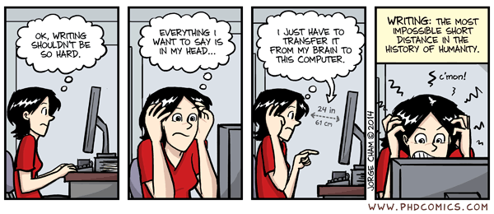
Writing

Slide 36
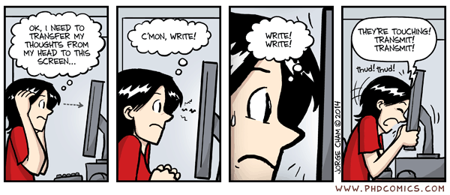
Writing

Slide 37
Writing
Reviewing a poorly written paper
Clear presentation
Terse
Careful about wording
Make claims with strong evidence

Slide 38
Writing
Matt Welsh’s blog on scientific writing
Sharpen your mental focus
Force you to obsess over every meticulous detail – word choice, word count, overall tone, readability of graphs (and others such as font size, layout and spacing, and page limit)

Slide 39
Writing
Crystalizing the ideas through the process of putting things together
Hone the paper to a razor-sharp, articulate, polished work

Slide 40
Writing
Write the paper as early as possible, sometimes before even starting the research work
Will discover the important things that you have not thought about
The process of writing results in a flood of ideas

Slide 41
Writing
Even if a paper is not accepted, the process is energizing and often lead to new ideas for the next research problems
Submitting the paper is often the start of a new line of work
Riding on that clarity of thought would emerge post-deadline (and a much-needed break)

Slide 42
Tell A Good Story
Good ideas and convincing results
But not too much (vs grant proposal)

Slide 43
Presentation
Good artists copy, great artists steal
Not just sugar coating
Not just a good spin
Tell a convincing story with solid evidence
Present your ideas with style
Q&A
Real stories

Slide 44
Interesting Title
Cool titles attract people
Grab people’s attention
Buzz word?
But don’t be provocative

Slide 45
Math Equations
Minimal number of equations
  No more, no less
  Too many details simply make a paper inaccessible
Too few equations
Many good papers have no or few equations
  CVPR 13 best paper
  CVPR 05 HOG paper

Slide 46
Figures
Be clear
Sufficient number of figures

Slide 47
Theoretical or Applied?
Computer vision is more applied, at least nowadays
Theory vs real world
More high impact papers are about how to get things done right

Slide 48
Common Mistakes
Typos
Unsupported claims
Unnecessary adjectives (superior!)
“a”, “the”
Inanimate objects with verbs
Inconsistent usage of words
Laundry list of related work (or worse copy sentences from abstracts)
Bad references
Laundry list of related work
Repeated boring statements

Slide 49
Get Results First than Writing?
Conventional mode
  Idea-> Do research -> Write paper
“How to write a great research paper” by Simon Peyton Jones
  Idea -> Write paper -> Do research
    Forces us to be clear, focused
    Crystallizes what we don’t understand
    Opens the way to dialogue with others: reality check, critique, and collaboration
My take
  Idea -> Write paper -> Do research -> Revise paper -> Do research -> Revise paper -> …

Slide 50
Supplementary Material
Important
Add more results and large figures
Add technical details as necessary (don’t miss important details)
Derivation details, e.g., proof of a theorem

Slide 51
Most Important Factors
Novelty
Significant contributions (vs. salami publishing)
Make sure your paper is non-rejectable (above the bar with some error margin)

Slide 52
Reviews
Me: Here is a faster horse
R1: You should have used my donkey
R2: This is not a horse, it’s a mule
R3: I want a unicorn!

Slide 53
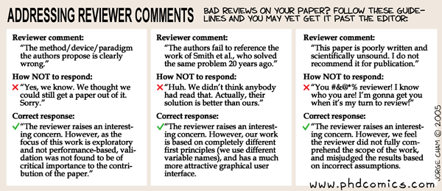
Rebuttal or Response
Good surprise | Bad surprise
One CVPR paper: BR, BR, DR Two ECCV paper: PR, PR, BR One CVPR 15 paper: BR, BR, WR -> poster, poster, poster One CVPR 15 paper: DR, WA, BR -> Poster, Poster, WR | Two ECCV papers: PA, PA, BR One CVPR 15 paper: WA, BR, BR -> Poster, Poster, WR One CVPR 16 paper: WR, WR, BR

Slide 54
Never Know What will Happen
Masked Meta-Reviewer ID: Meta_Reviewer_1
Meta-Reviews:
Question
Consolidation Report
All reviewers agree that this paper has moderate novelty of using partial and spatial information for sparse representation. However, they also concern about
- unclear presentation on technical details (eg. definitions, inference algorithm, pooling methods, template updating schemes, experimental settings etc.),
- not extensive experimental comparison (needs tests on more challenging videos),
- missing justification of the assumption (complementary nature of two kinds of pooling features) and the efficacy of each term.
The authors rebuttal addresses most issues, but is not sufficient to ease the main concerns of R1 and R2. So, the AC recommends the paper to be rejected as it is.
Decision
Definitely Accept

Slide 55
Challenging Issues
Large scale
  CVPR 2011 best paper: pose estimation
  CVPR 2013 best paper: object detection
Unconstrained
Real-time
  CVPR 2001: face detector
  CVPR 2006: scalable object recognition
Robustness
Recover from failure

Slide 56
Interesting Stats
Best papers and top cited papers in computer science
Best papers = high impact?
Oral papers are more influential?
CVPR Longuet-Hggins prize
ICCV Helmholtz award

Slide 57
Data Set Selection
NIPS 02 by Doudou LaLoudouana and Mambobo Bonouliqui Tarare, Lupano Tecallonou Center, Selacie, Guana
The secret to publish a paper in machine learning conferences?
Read the references therein carefully!

Slide 58
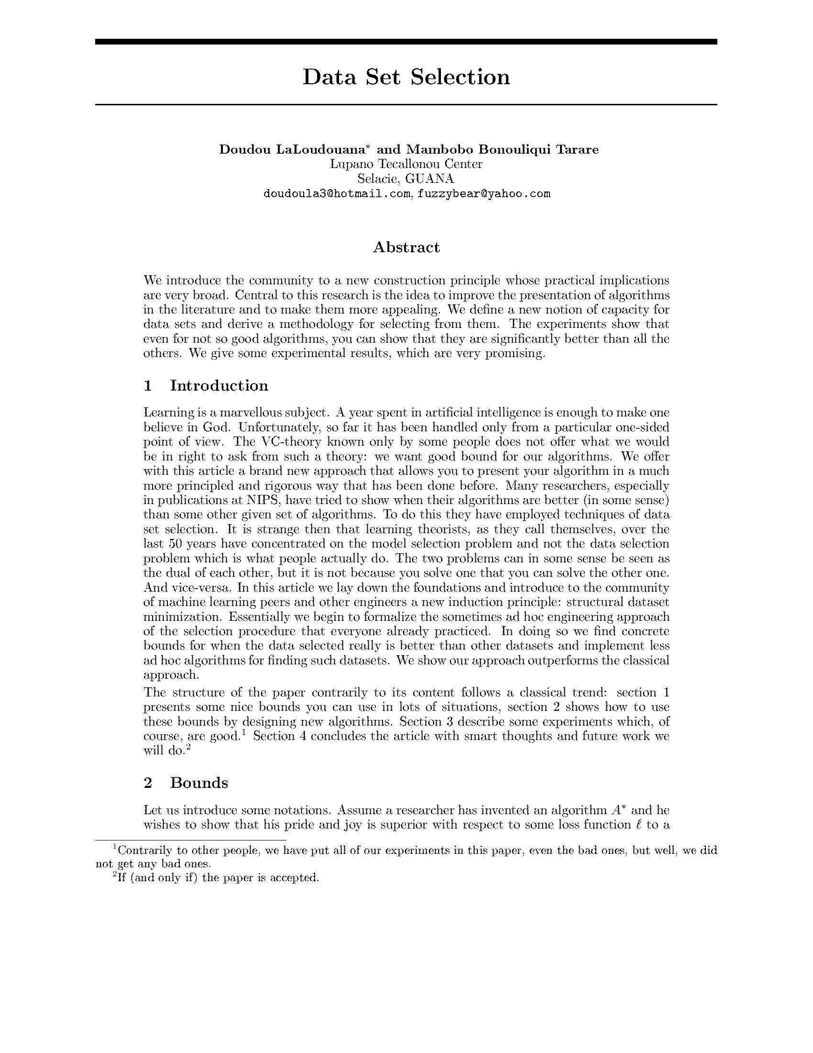
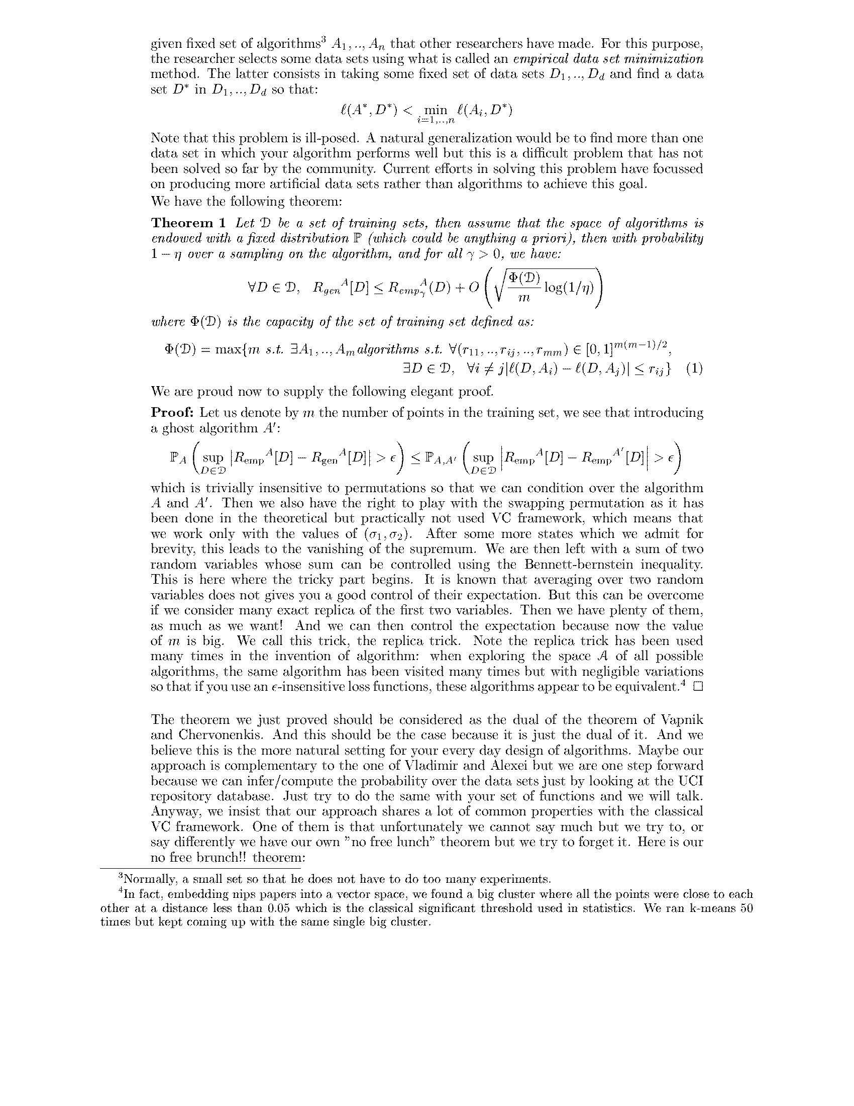
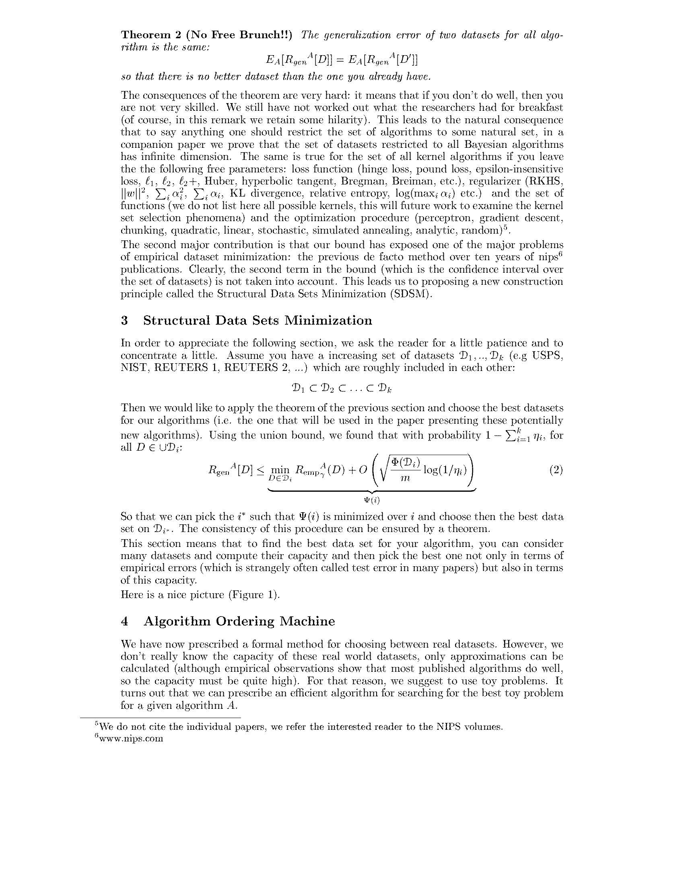
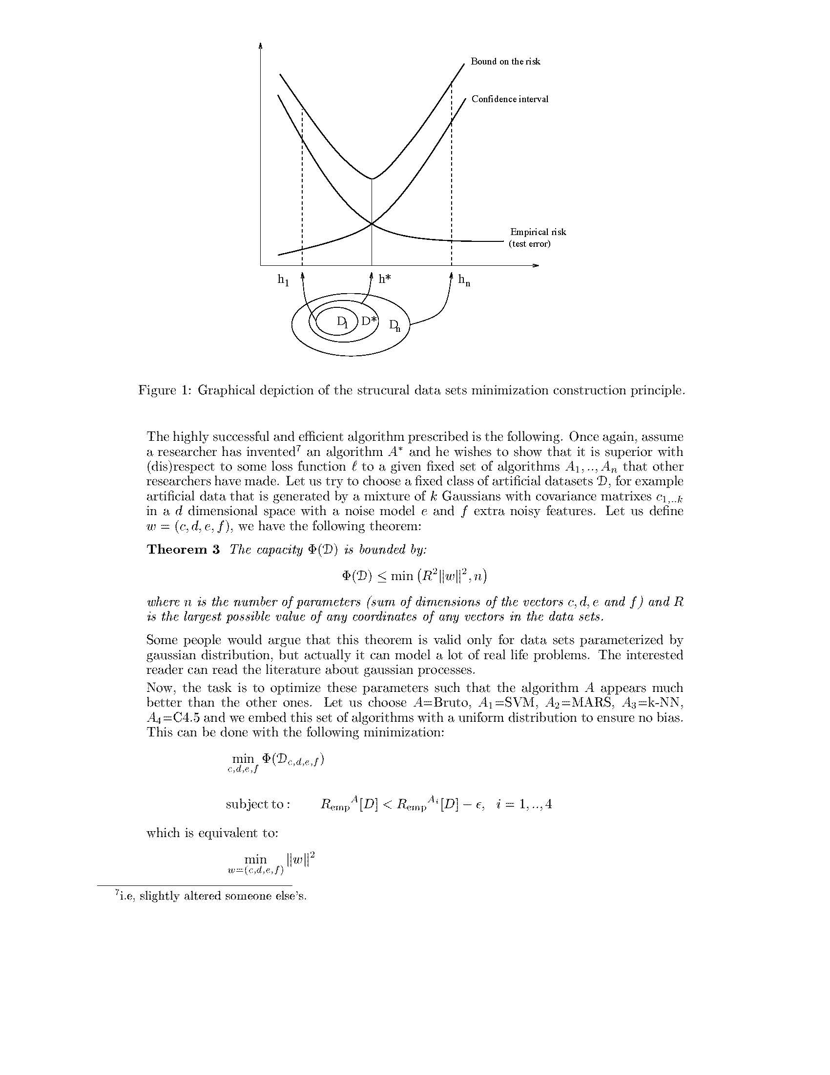
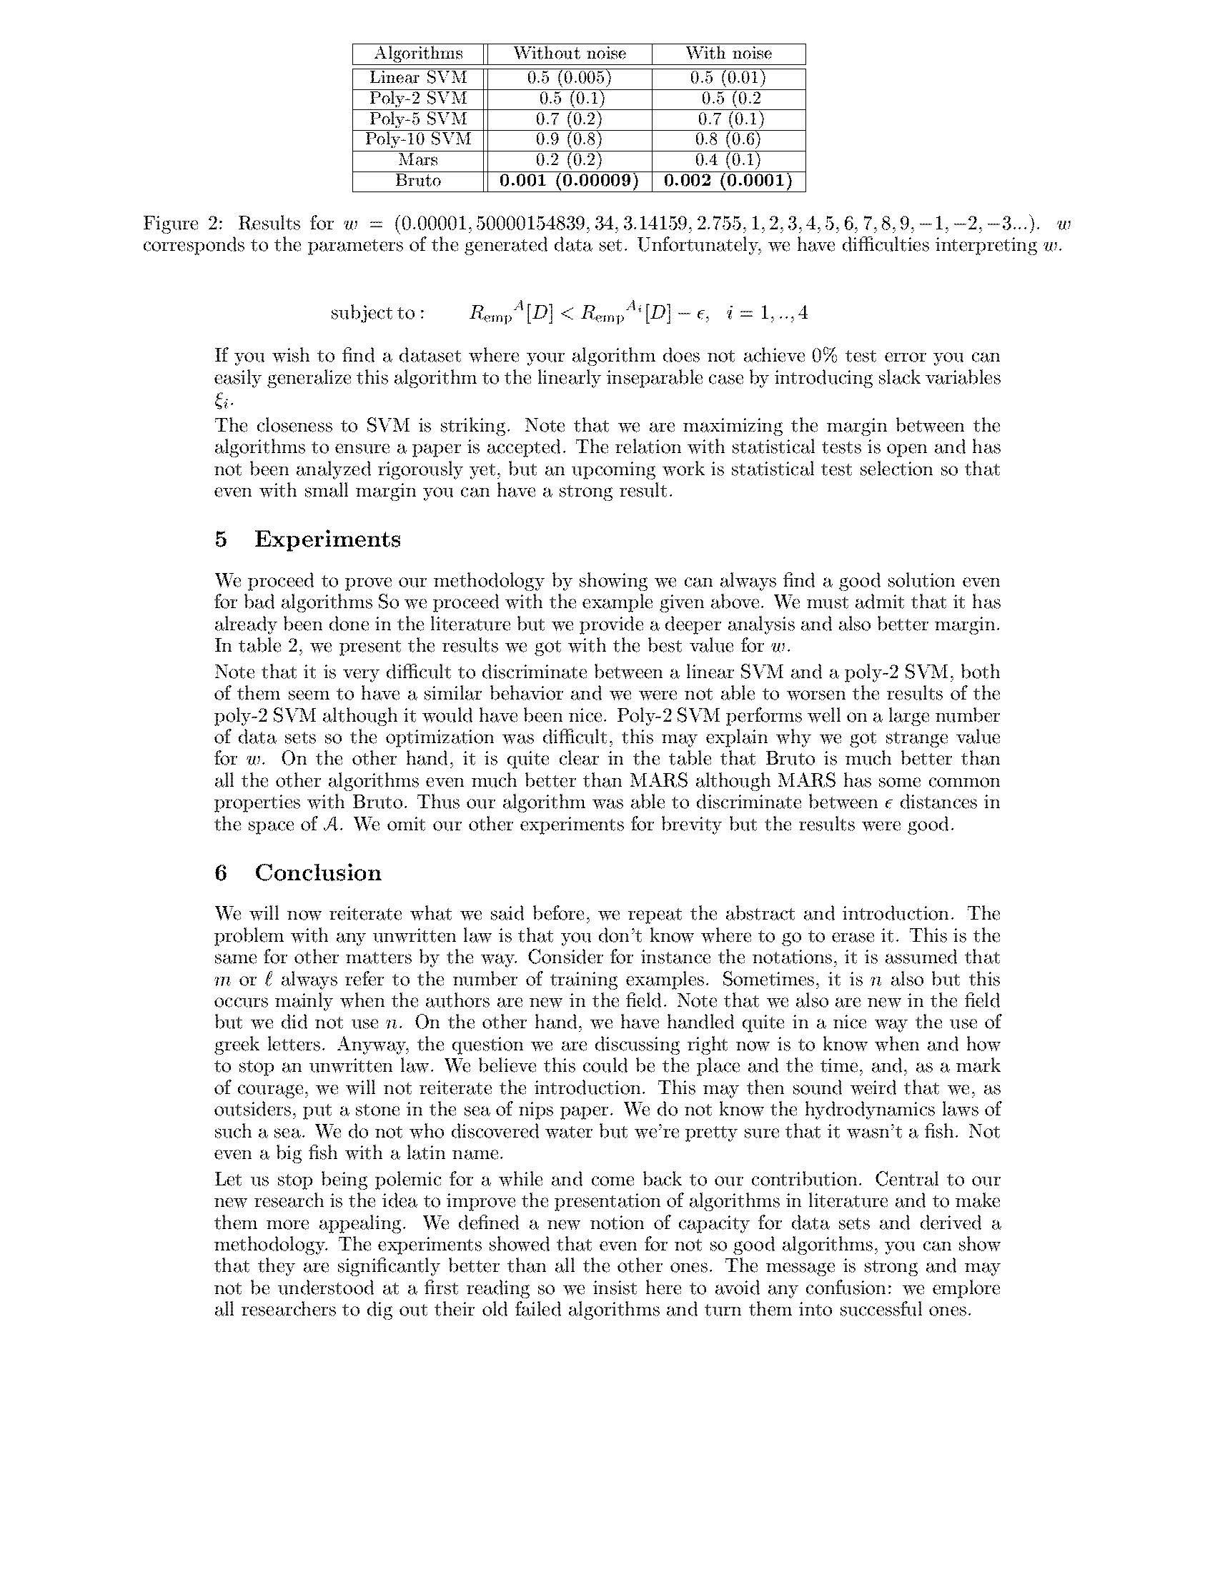
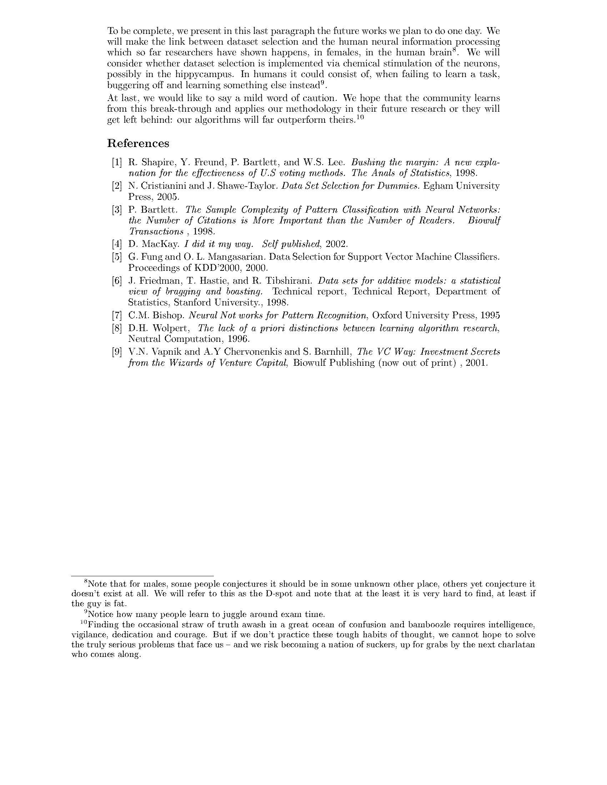
Data Set Selection

Slide 59
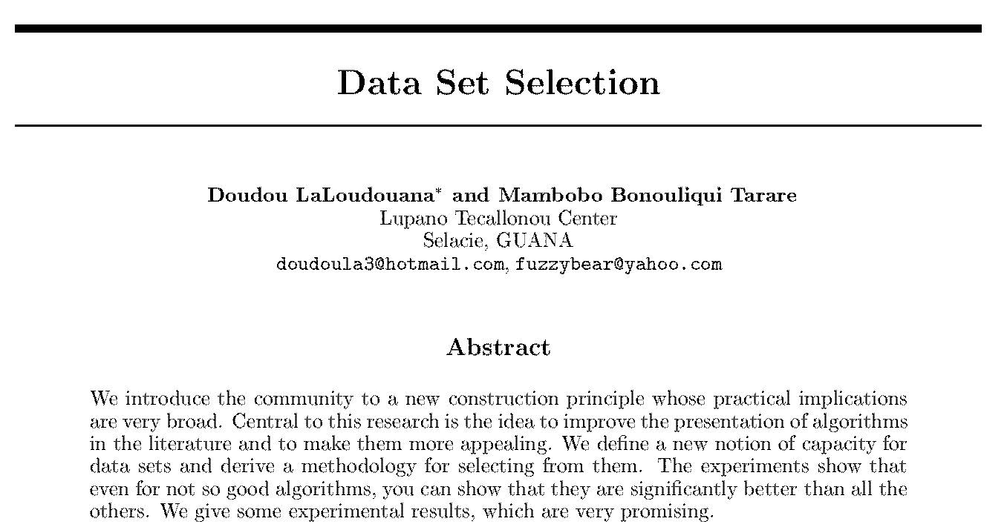
Data Set Selection

Slide 60
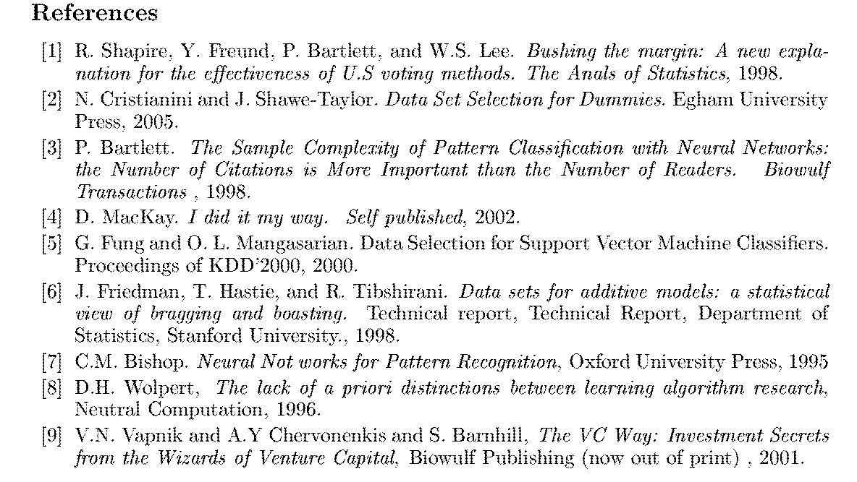
Data Set Selection
(originally) [6] ... a egotistical view of bragging and boasting.....

Slide 61
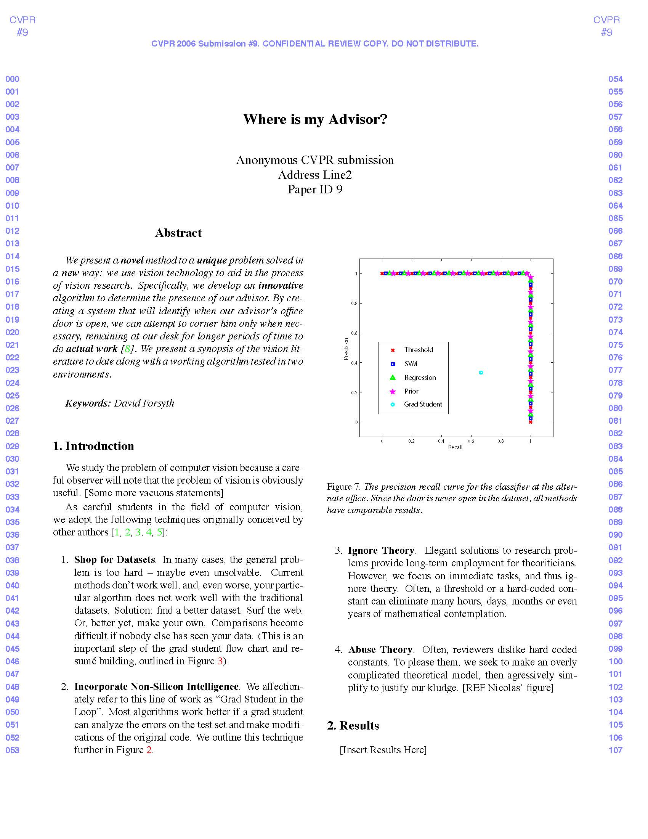
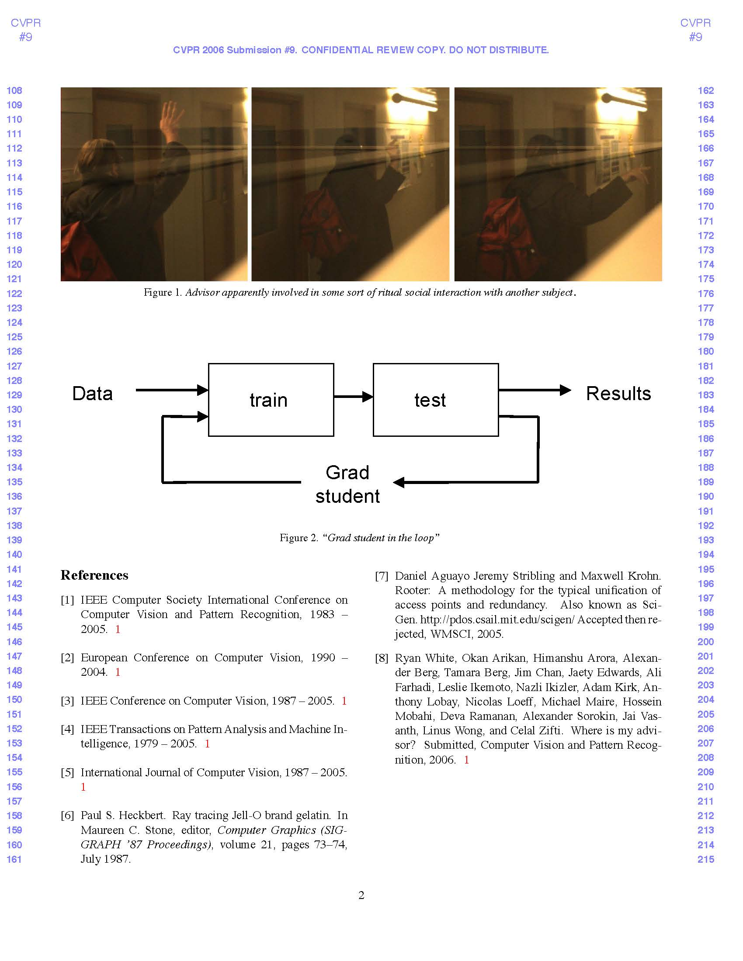
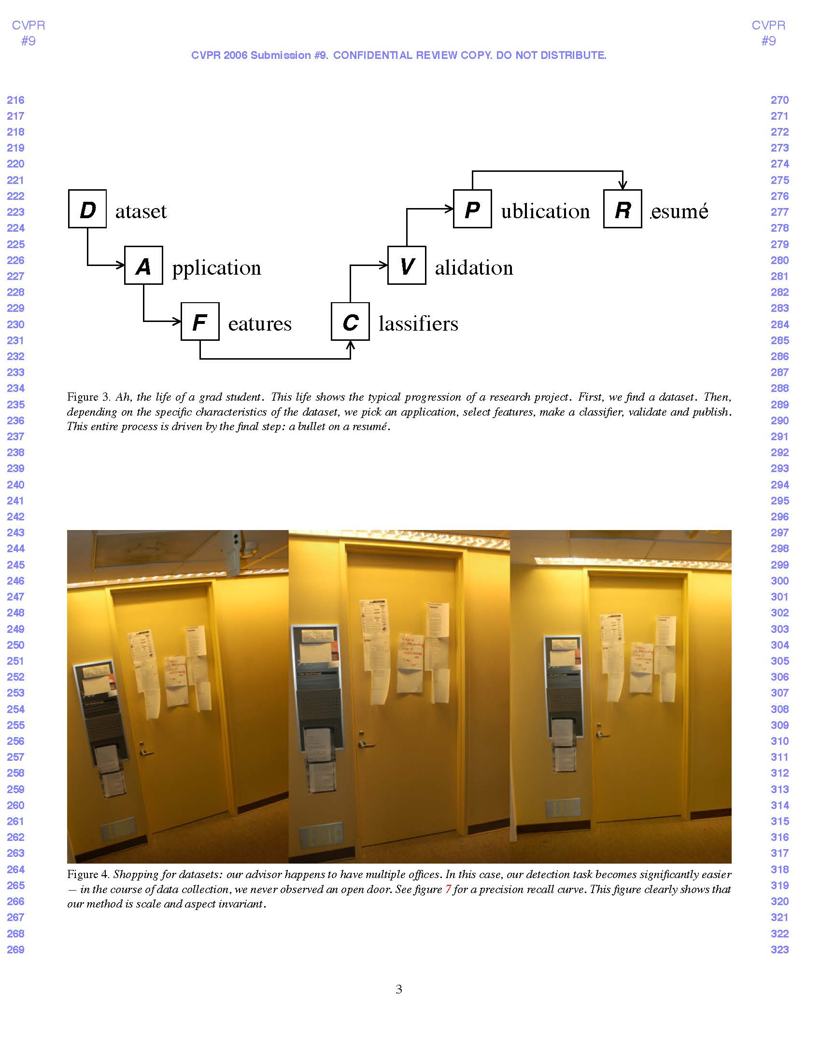
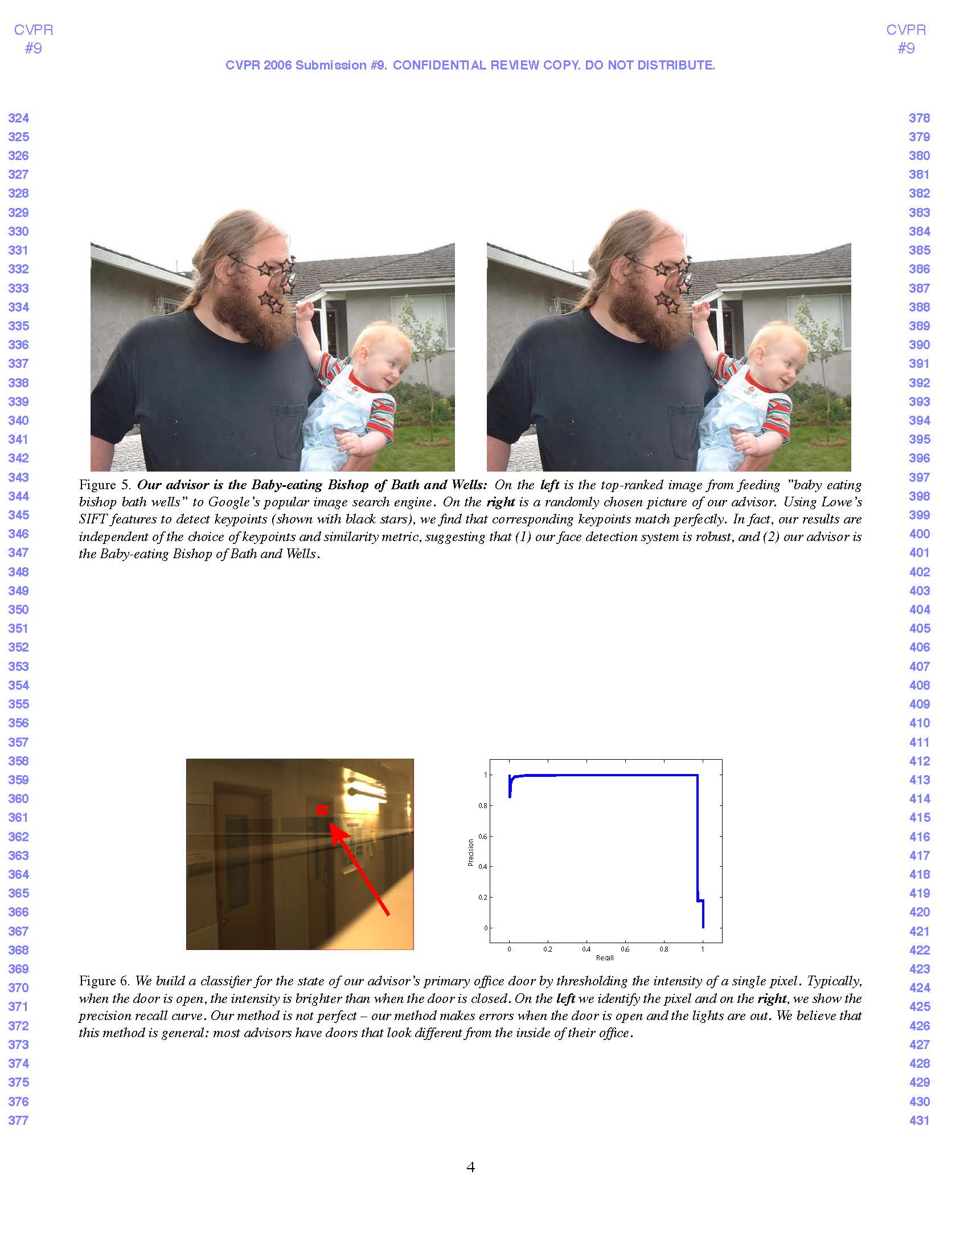


Where Is My Advisor?

Slide 62
Ask Someone to Proofread
Certainly your advisor
Polish your work
My story

Slide 63
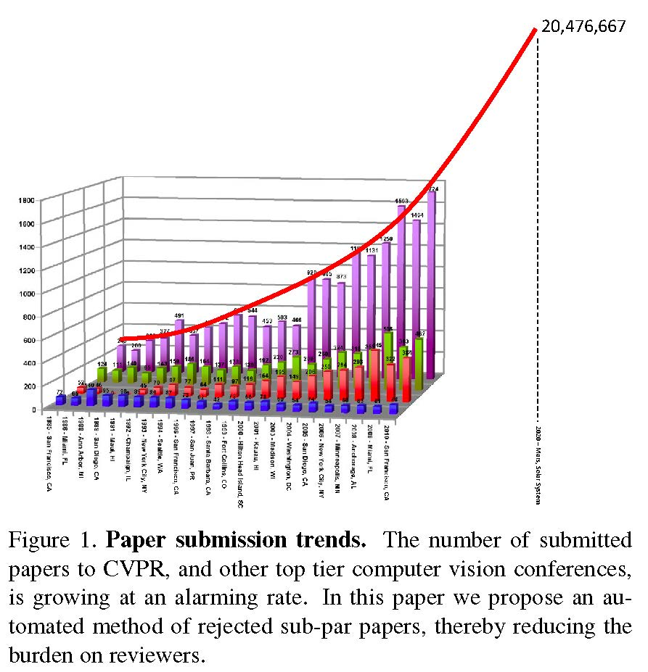
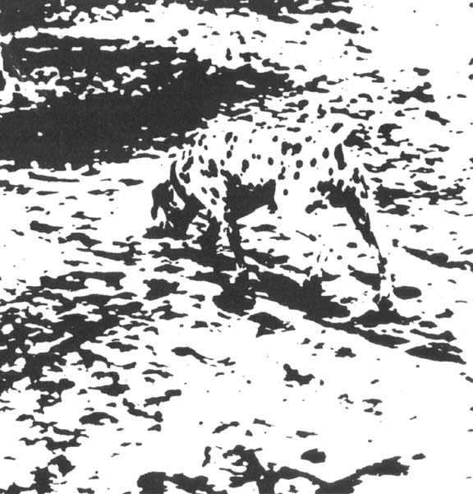

Paper Gestalt

Slide 64
Paper Gestalt
CVPR 10 by Carven von Bearnensquash, Department of Computer Science, University of Phoenix
Main Point: Get your paper looking pretty with right mix of equations, tables and figures

Slide 65
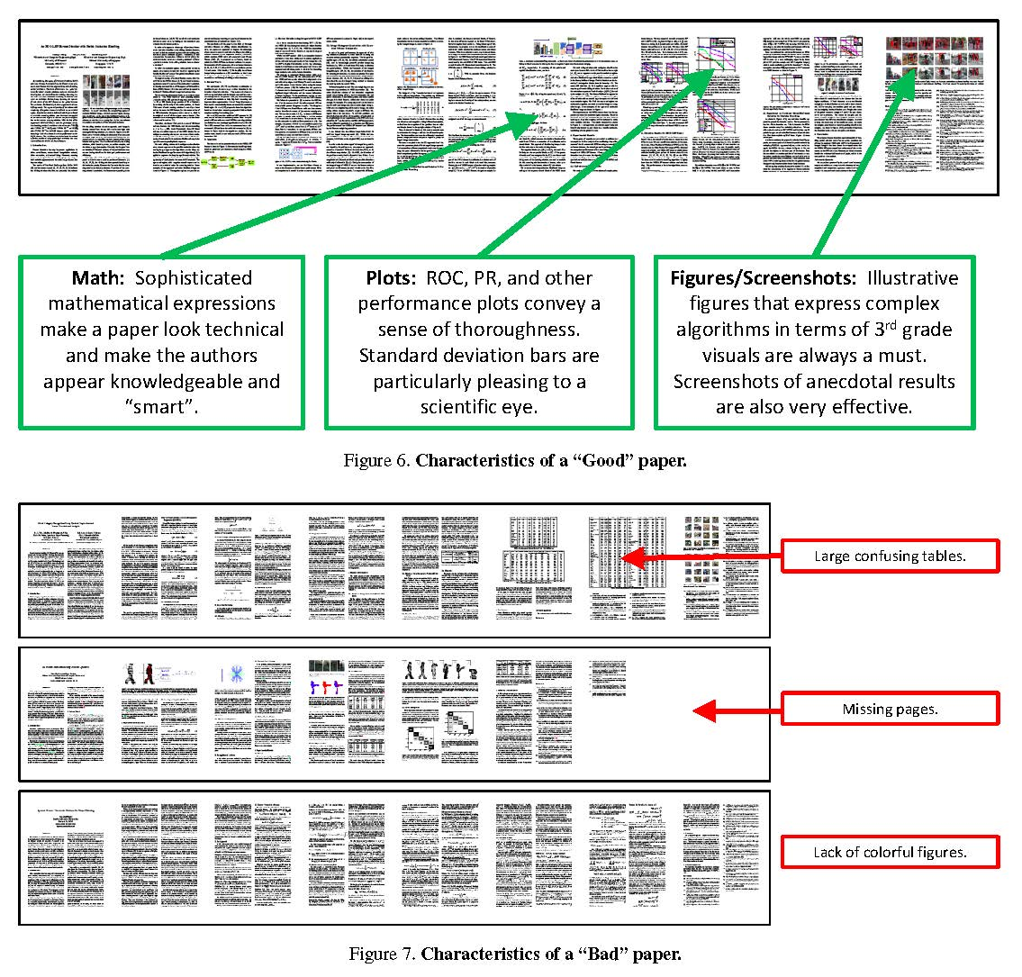

Slide 66
Tools
Google scholar h-index
Software: publish or perish
DBLP
Mathematics genealogy
Disclaimer:
  h index = significance?
  # of citation = significance?

Slide 67
Basic Rules
Use LaTeX
Read authors’ guideline
Read reviewers’ guideline
Print out your paper – what you see may NOT be what you get
Submit paper right before deadline
  Risky
  Exhausting
  Murphy’s law
Do not count on extension

Slide 68
Lessons
Several influential papers have been rejected once or twice
Some best papers make little impact
Never give up in the process

Slide 69
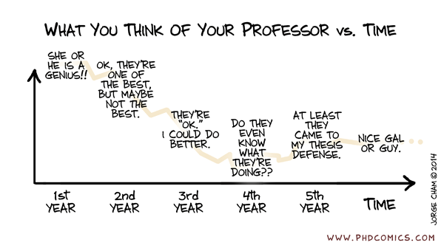
Karma?

Slide 70
Your Advisor and You
Suggesting a research topic
When your advisor presents your work
When you explain your work
Demos
Good results

Slide 71
Start Working Early!
Write, write, write…
Ask others for comments

Slide 72
Work Hard in the Summer

Slide 73
Quotes from Steve Jobs
“ I'm convinced that about half of what separates successful entrepreneurs from the non-successful ones is pure perseverance. ”
“ Creativity is just connecting things. When you ask creative people how they did something, they feel a little guilty because they didn't really do it, they just saw something. It seemed obvious to them after a while. ”

